Slide 1
UNIT-V
Mongo DB: Introduction, Importance of NoSQL databases, JSON features, Data types and examples. CRUD Operations, Data Modelling & Schema Design, Indexing and Aggregation, Mongo Import/Export and Master/Slave Replication.

Slide 2
Intro
MongoDB is the most popular and trending database.
The vendor: MongoDB
https://www.mongodb.com/
Where we can use MongoDB database?
----------------------------------
We can use everywhere
For desktop applications, for mobile applications
For web applications, this database is more popular.

Slide 3
Who will use
Full stack developer:
stack---->The technologies which can be used to develop web applications are called a stack.
The most popular stacks:
1. MEAN Stack
2. MERN Stack
1. MEAN Stack:
--------------
2. MERN Stack:
--------------
M --->MongoDB
E --->Express
R --->React JS
N --->Node JS

Slide 4
Contd.,
By using MEAN and MERN stacks we can build javascript based web applications.
Node JS is based on Java Script
React or Angular is based on Java Script
Express is based on Java Script
MongoDB is also based on Java Script.
MongoDB internally used Mozilla's Java Script Engine.

Slide 5
Relational Database vs Document Database:
There are 2 most common types of databases.
1. Relational Databases/SQl Databases
2. Document Databases/NoSQl Databases
1. Relational Databases/SQl Databases
--------------------------------------
The data will be stored in tables and these tables has fixed schema.
Employee(eno,ename,esal,eaddr)
The data stored in tables has relationships like
The data stored in tables has relationships like
one to one
one to many
many to one
etc

Slide 6
2. Document Databases/NoSQl Databases:
--------------------------------------
Data will be stored in separate documents and each document is independent of others.
eg: MongoDB
MongoDB Structure:
------------------
MongoDB Physical database contains several logical databases.
Each database contains several collections. Collection is something like table in relational database.
Each collection contains several documents. Document is something like record/row in relational database.

Slide 7
eg:
Database: Shopping cart database
Collections: Customers, Products, Orders
Cusomer Collection: contains several documents
document1:
{
"Name":"Sunny",
"age":40,
"Salary":10000
}
document2:
{
"Name":"Durga"
}
document-3:
{
"name":"Bunny",
"age":30,
"address":
{
"city":"Hyderabad"
},
"hobbies":[
{"name":"Cricket playing"},
{"name":"swimming"}
]
}

Slide 8
How data represented in MongoDB?
In JSON (BSON) Format.
JSON--->Java Script Object Notation
BSON--->Binary JSON

Slide 9
Key Characteristics of MongoDB database: ----------------------------------------
Installation and setup is very easy.
1. All information related to a document will be stored in a single place.
To retrieve data, it is not required to perform join operations and hence retrieval is very fast.
2. Documents are independent of each other and no schema. Hence we can store unstructured data like videos, audio files etc
3. We can perform oprations like editing existing document, deleting document and inserting new documents very easily.
4. Retrieval data is in the form of json which can be understandable by any programming language without any conversion (interoperability)
5. We can store very huge amount of data and hence scalability is more.
Note: Performance and Flexibility are biggest assets of Mongodb.

Slide 10
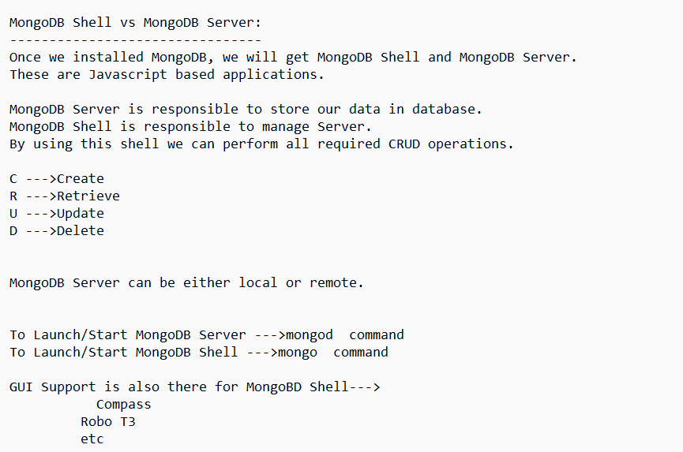

Slide 11
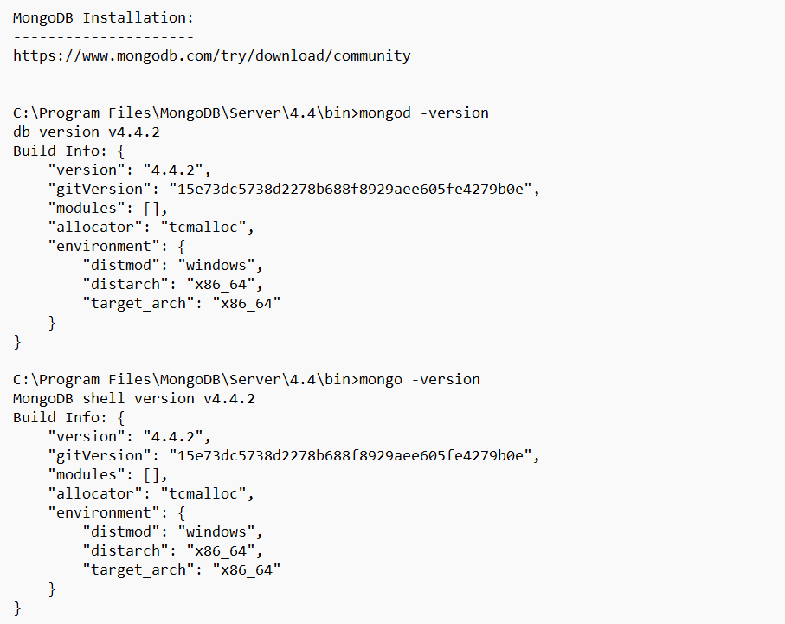

Slide 12
Data diretotry
Create the data directory or specify another path using (1) the --dbpath command line option, or (2) by adding the 'storage.dbPath' option in the configuration file."}}
mongod --dbpath "C:\data\db"

Slide 13
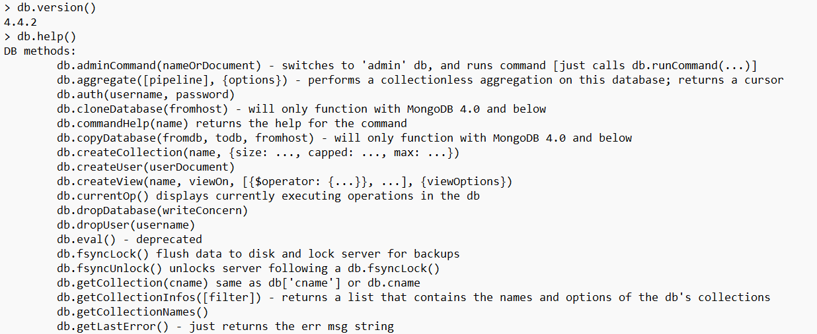

Slide 14
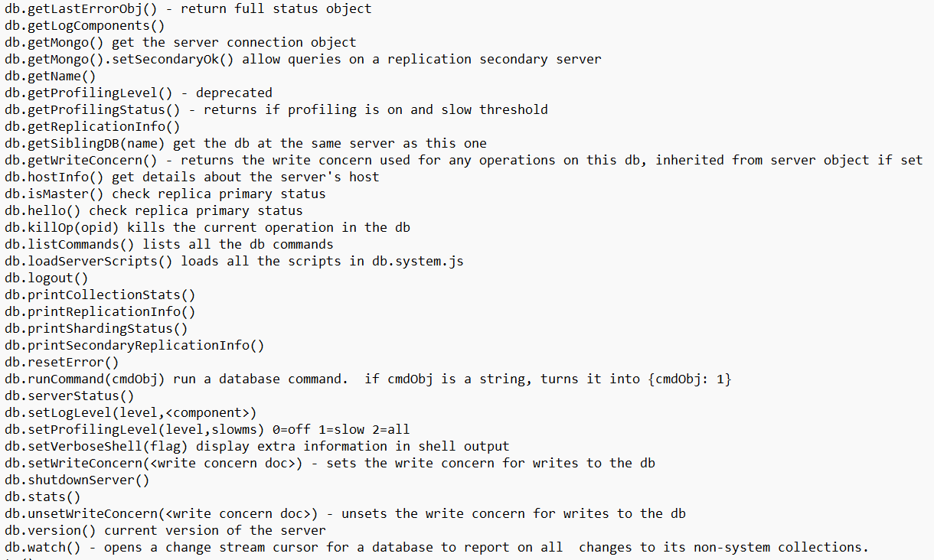

Slide 15
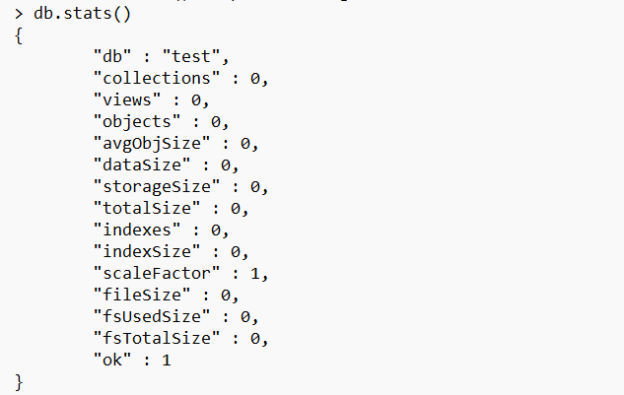

Slide 16
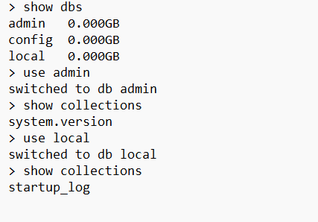

Slide 17
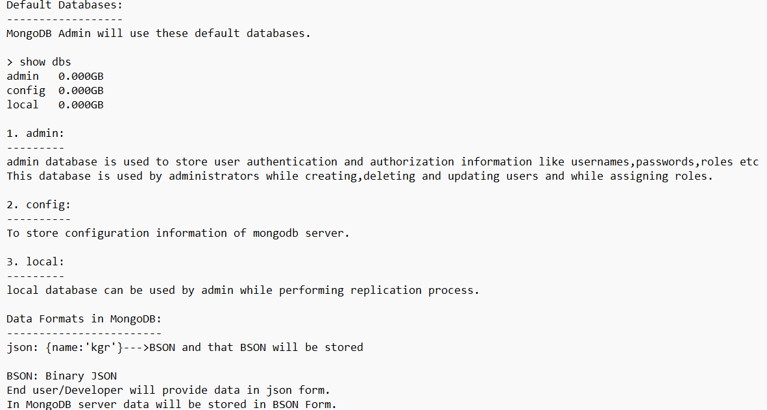

Slide 18
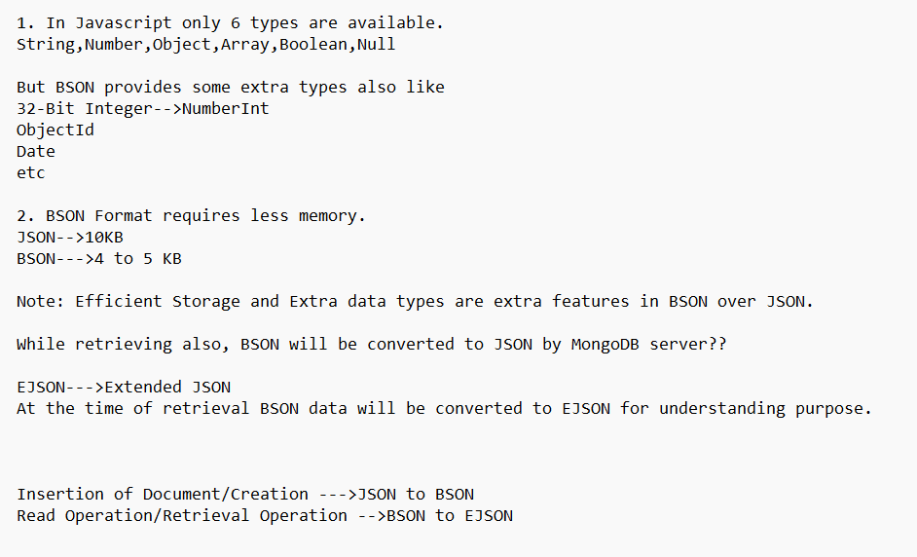

Slide 19
Q. What data formats used in MongoDB?
3 formats: JSON,BSON,EJSON

Slide 20
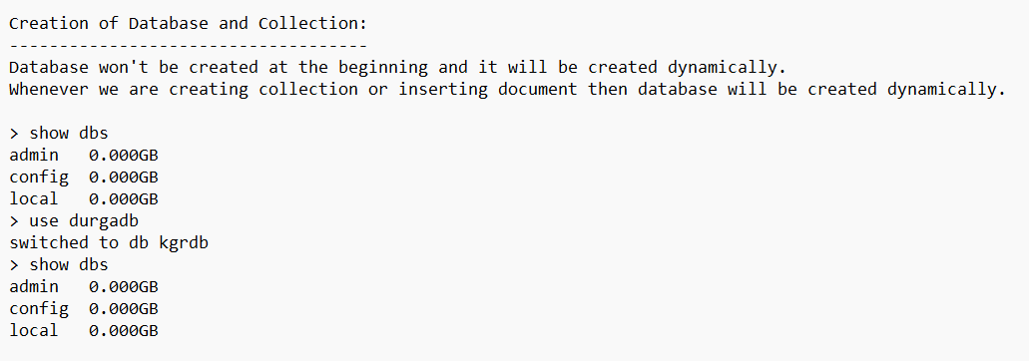

Slide 21
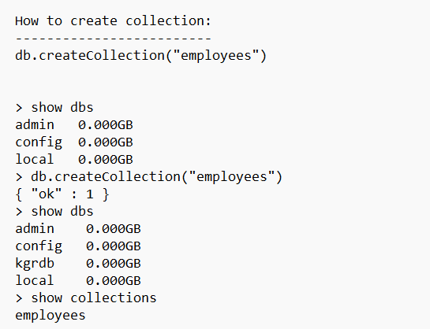

Slide 22
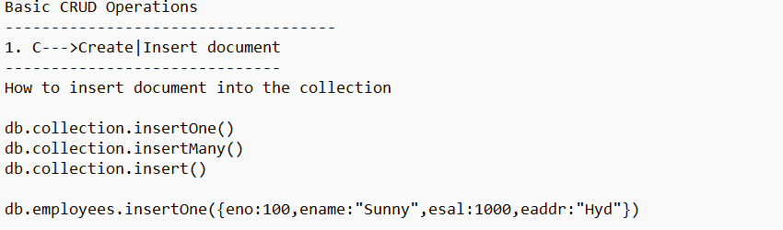

Slide 23
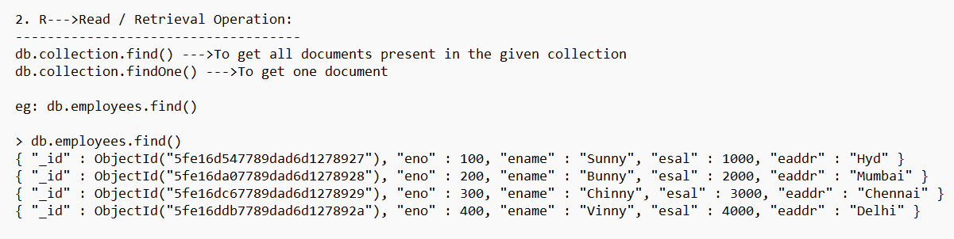

Slide 24
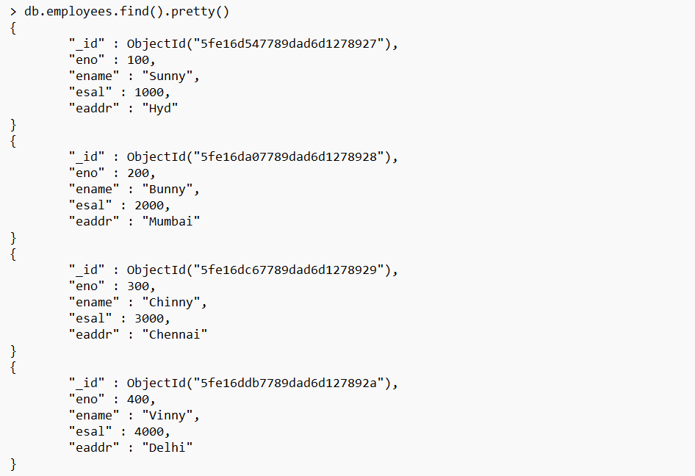

Slide 25
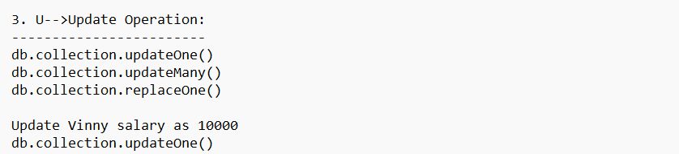

Slide 26
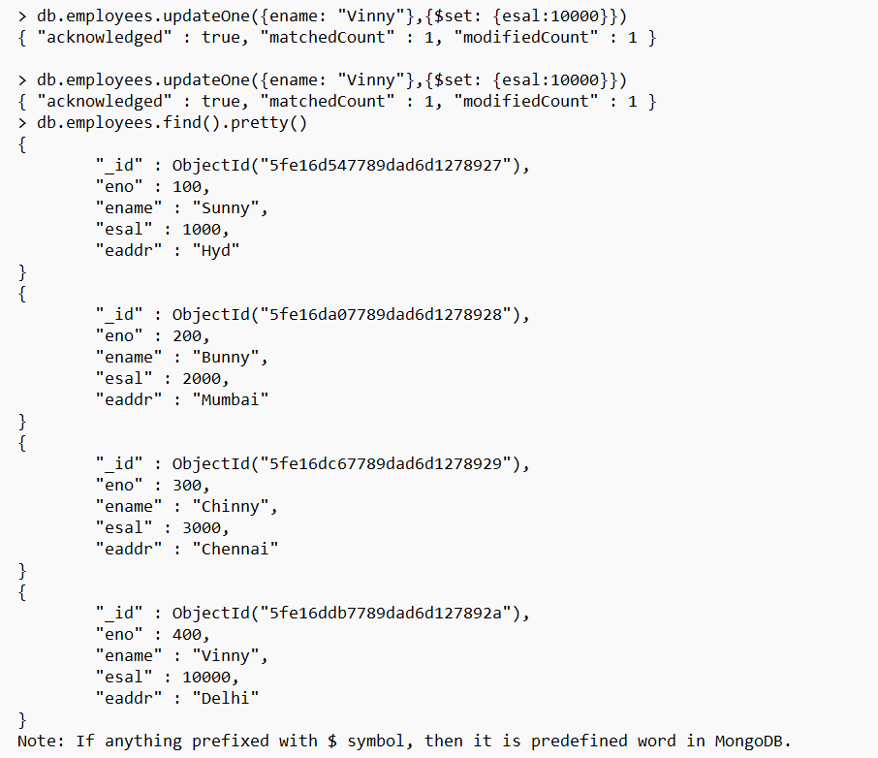

Slide 27
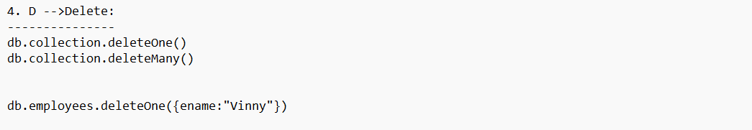

Slide 28
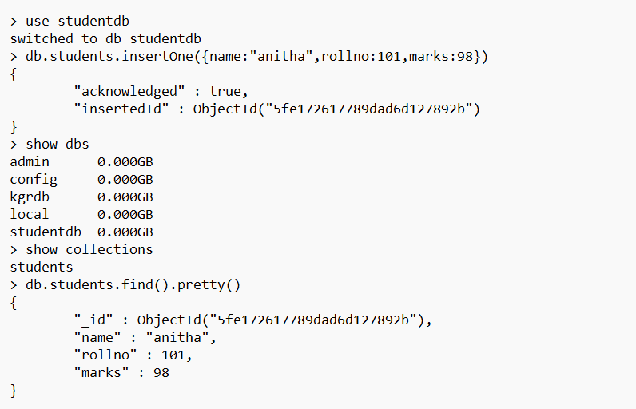

Slide 29
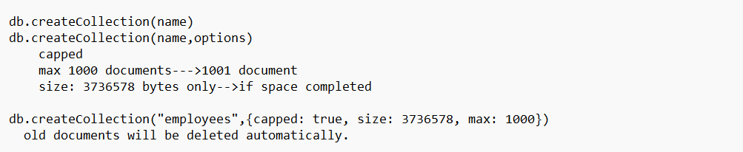

Slide 30
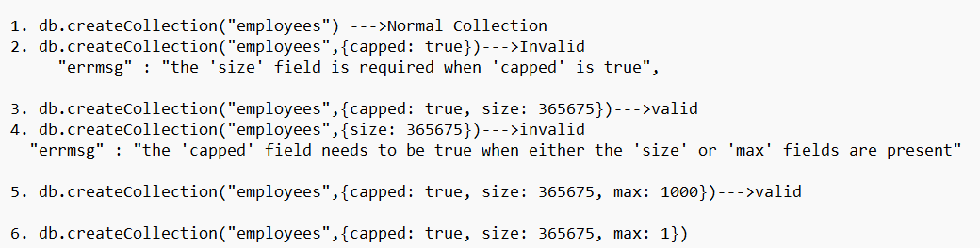

Slide 31
Q. What is capped collection?
If size exceeds or maximum number of documents reached, then oldest entry will be deleted automatically, such type of collections are called capped collections.

Slide 32
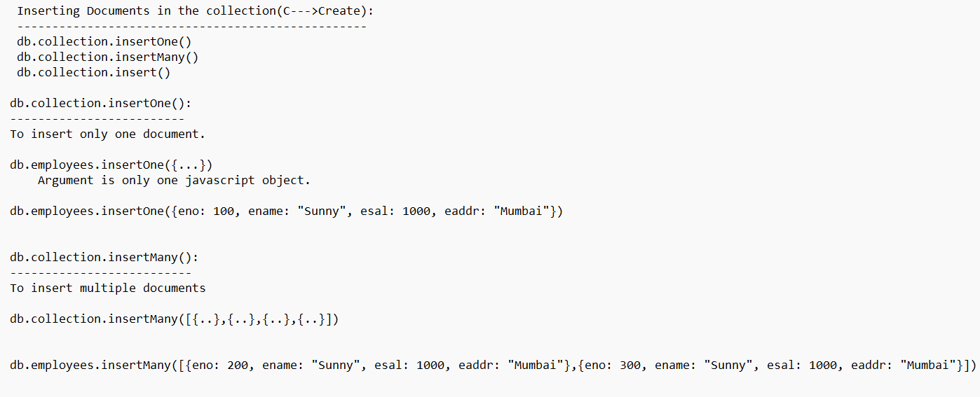

Slide 33
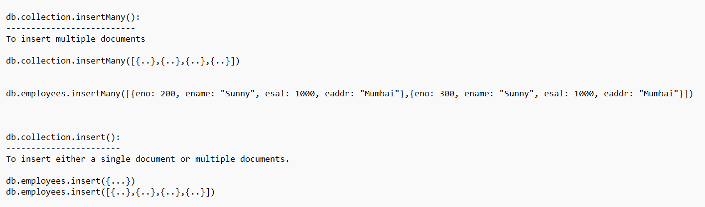

Slide 34
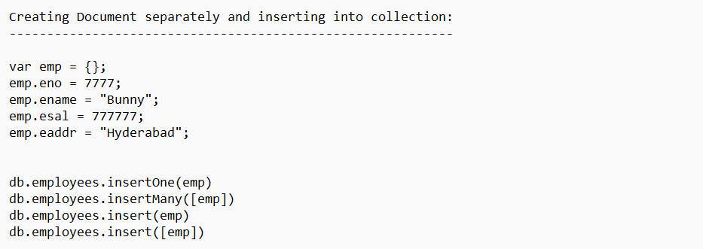

Slide 35
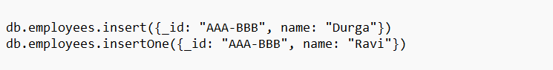
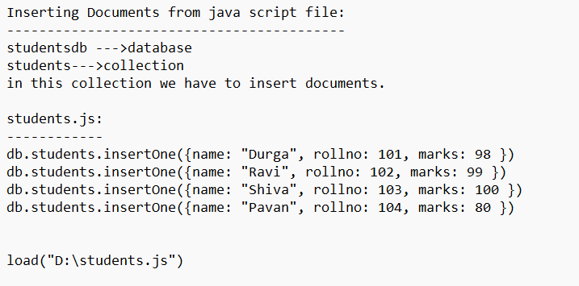

Slide 36
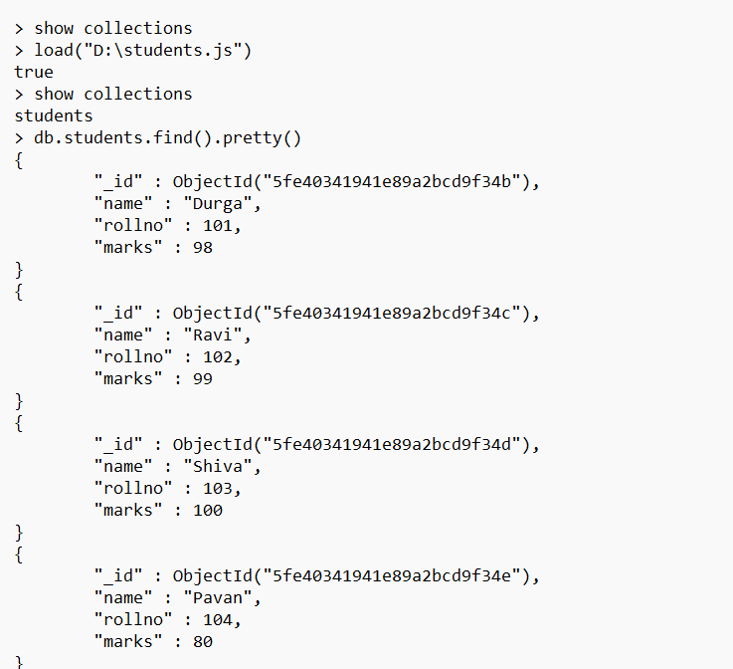

Slide 37
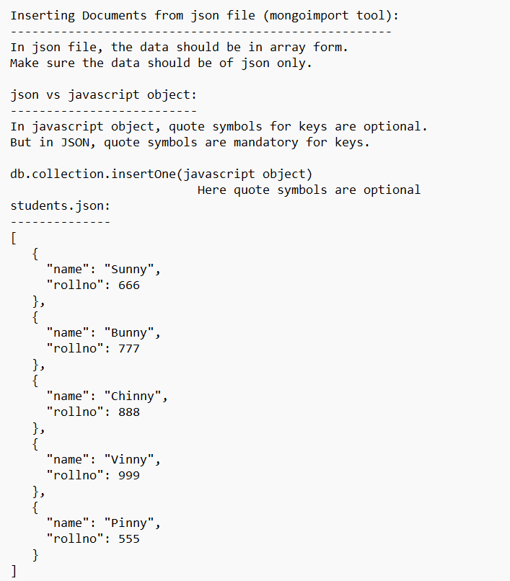

Slide 38
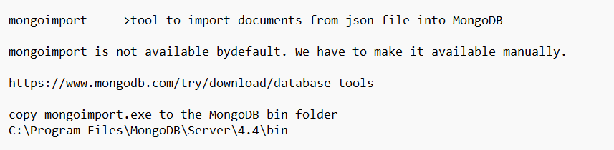

Slide 39
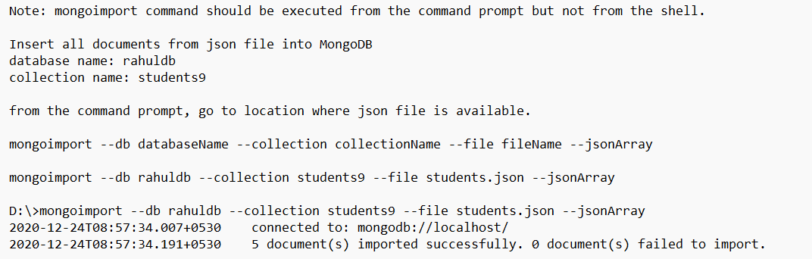

Slide 40
Note:
mongoimport creates database and collection automatically if not available.
If collection already available then the new documents will be appended.

Slide 41
> use rahuldb
switched to db rahuldb
> show collections
students9

Slide 42
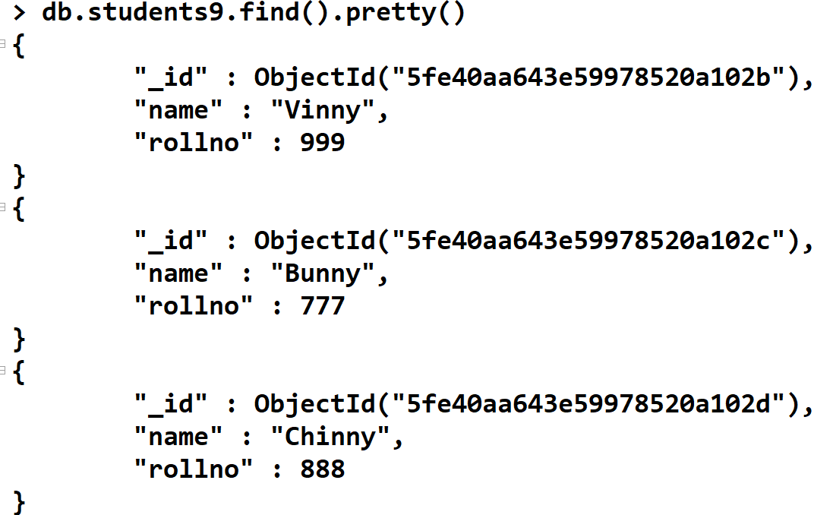

Slide 43
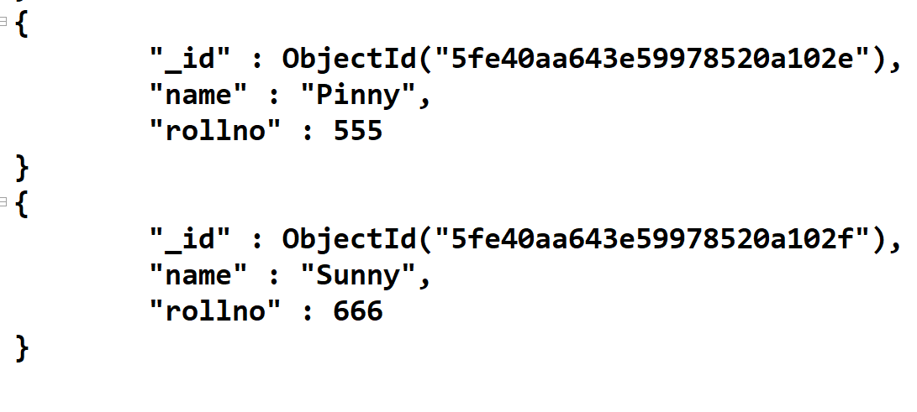

Slide 44
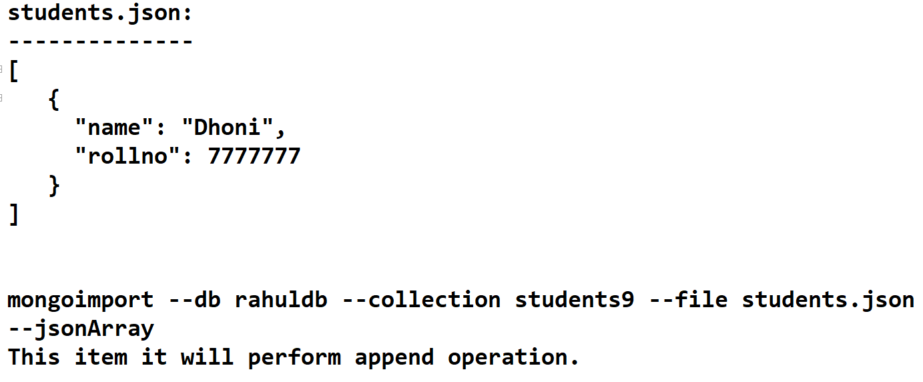

Slide 45
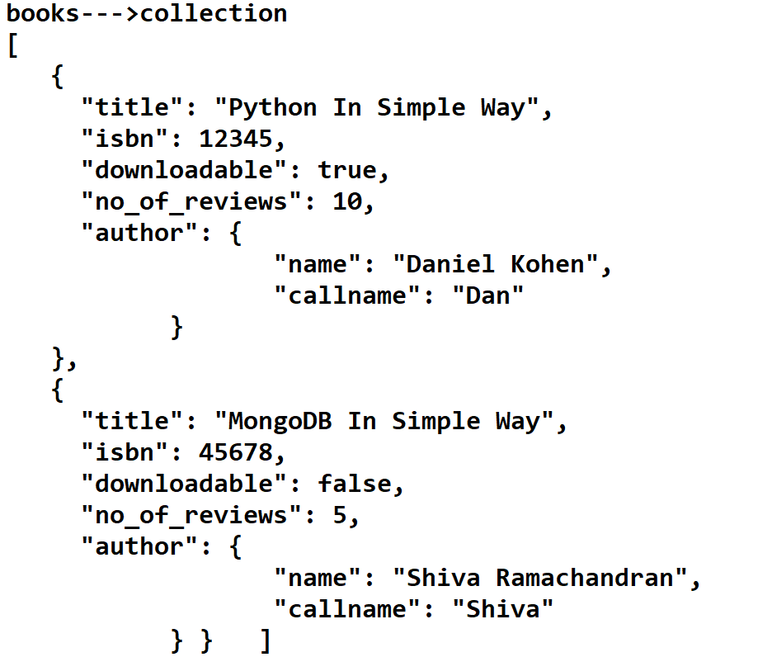

Slide 46
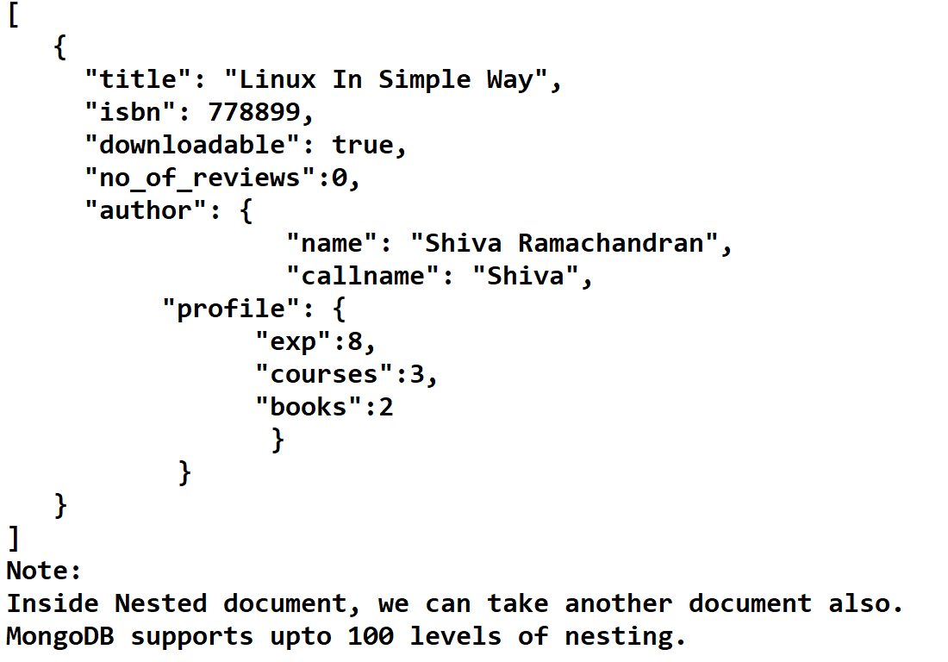

Slide 47
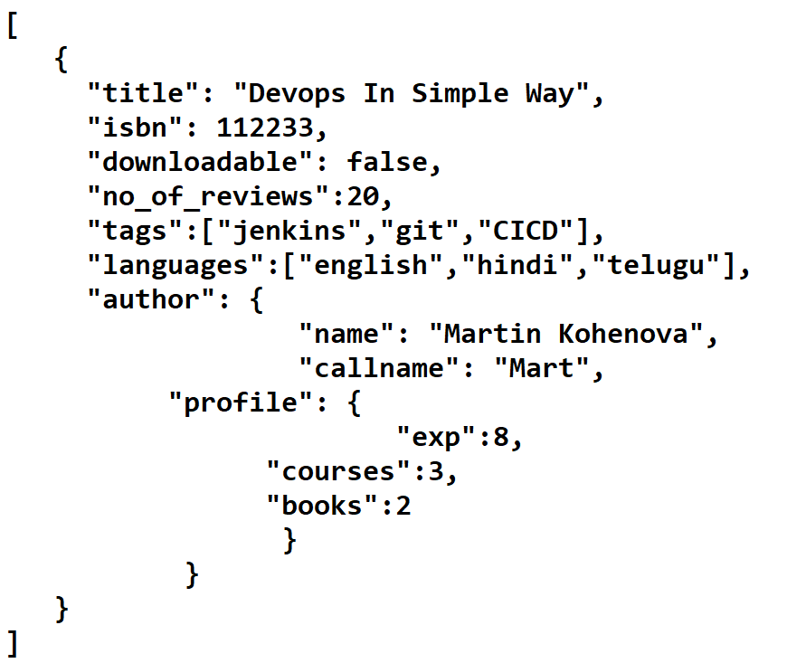

Slide 48
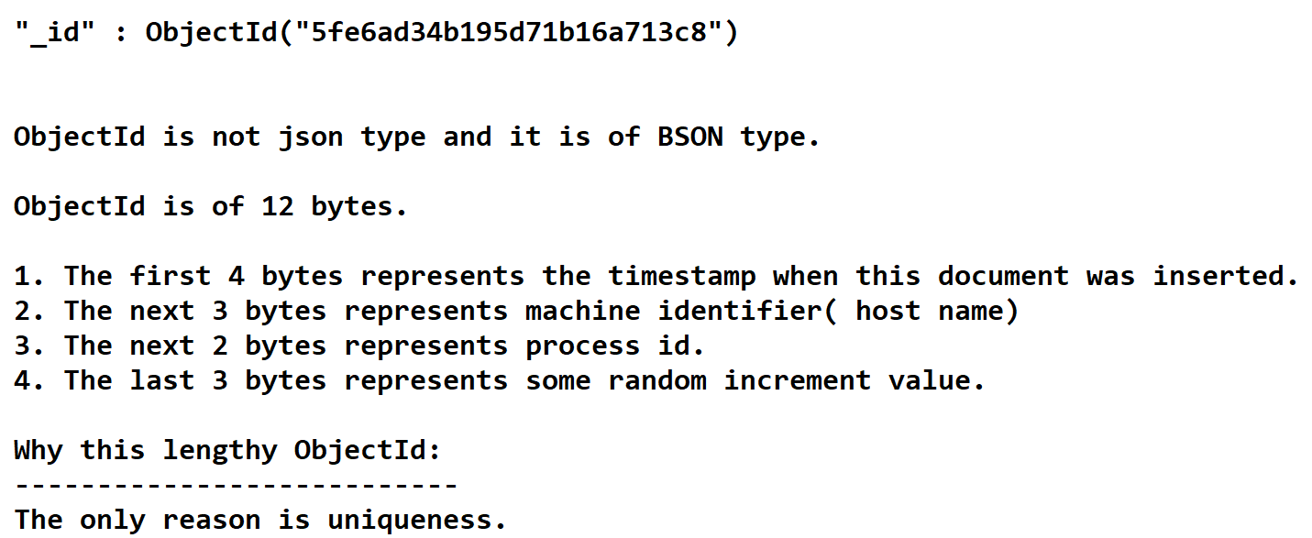

Slide 49
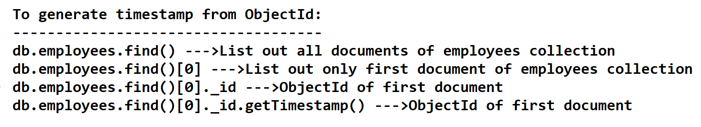

Slide 50
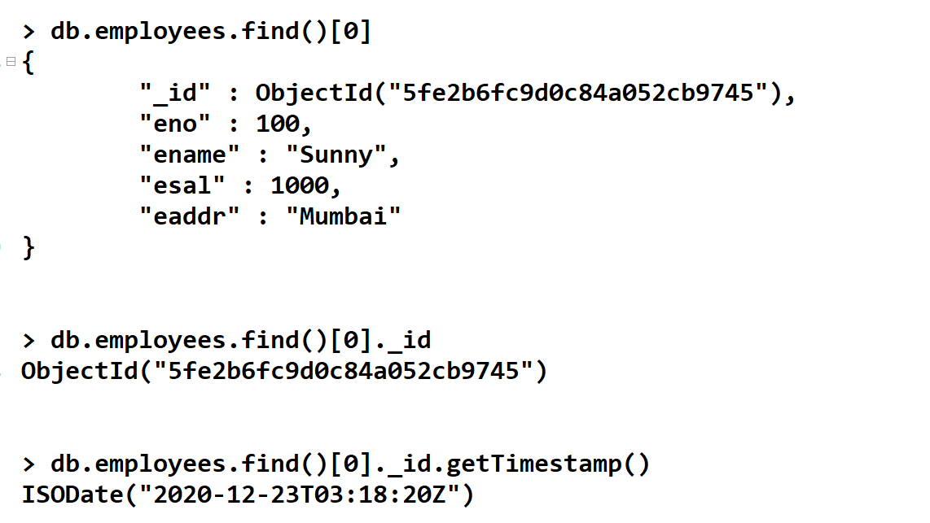

Slide 51
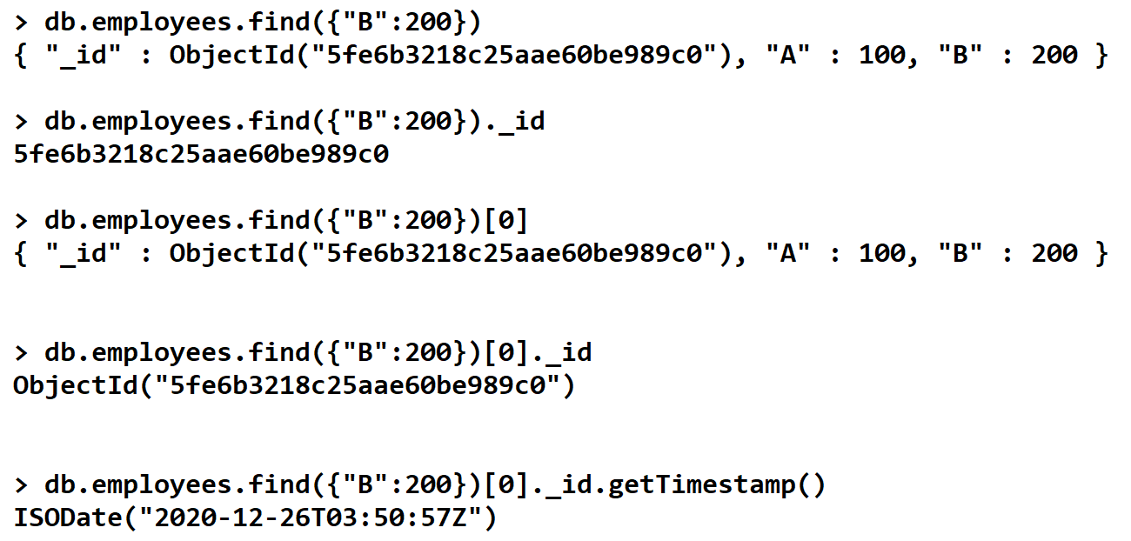

Slide 52
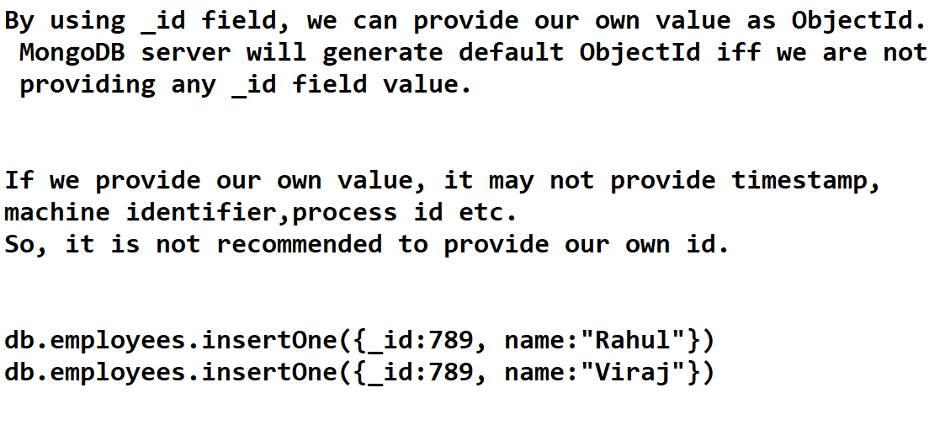

Slide 53
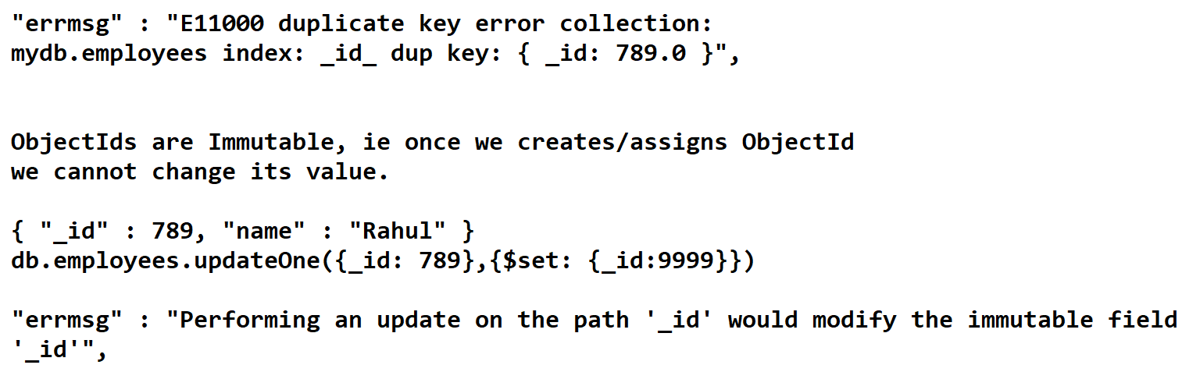

Slide 54
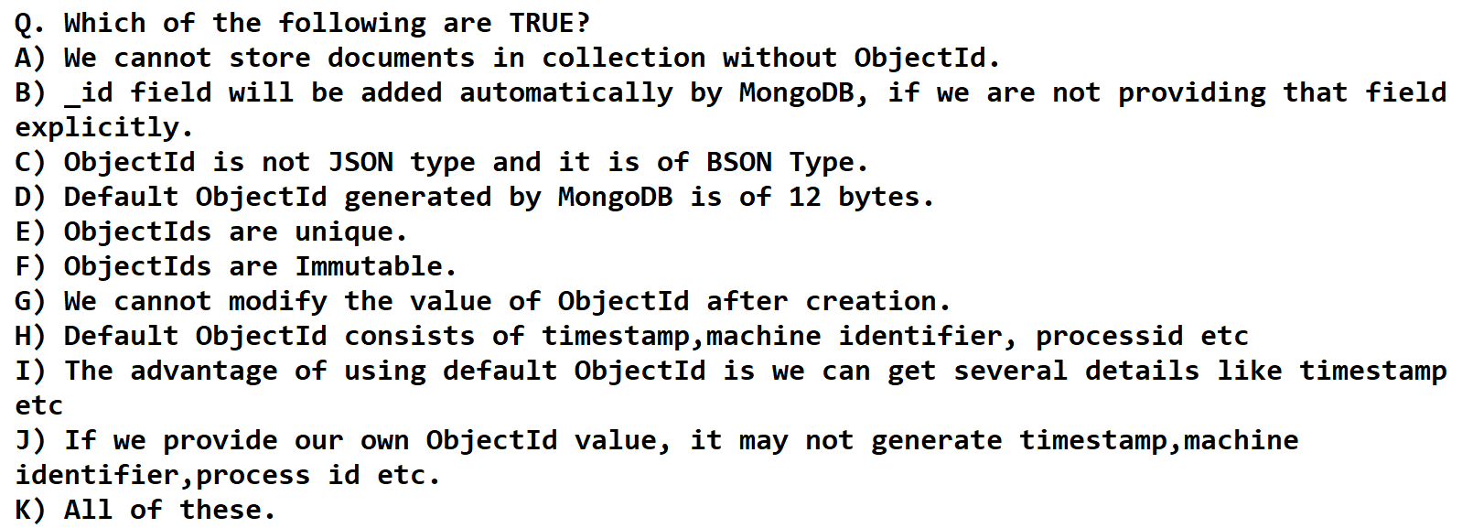

Slide 55
While performing bulk insert operation, if any document insertion fails then rest of the documents won't be inserted. i.e in bulk inserts, order is important.
The documents which are already inserted won't be rollbacked.
We can customize this behavior by using ordered property.
> db.cars.insertMany([{},{},...{}],{ordered: false})
The default value for ordered is true.

Slide 57
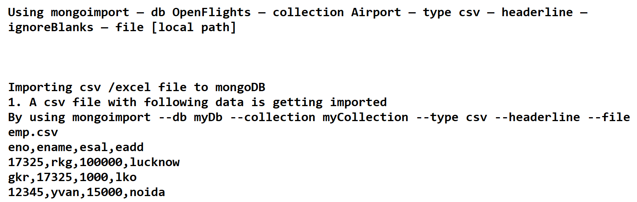

Slide 58
U--->Update Operation

Slide 59
We can perform updations like
1. Overwrite existing value of a particular field with our new value
2. Add a new field for selected documents
3. Remove an existing field
4. Rename an existing field

Slide 60
update methods:
We can perform required updations by using update methods and update operators.
There are 3 update methods are avaialble.
1. updateOne()
2. updateMany()
3. update()

Slide 61
1. updateOne():
db.collection.updateOne(filter,update,options)
It finds the first document that matches filter criteria and perform required updation. It will perform updation for a single document.
2. updateMany():
db.collection.updateMany(filter,update,options)
To update all documents that match the specified filter criteria.
3. update():
db.collection.update(filter,update,options)
We can use this method to update either a single document or multiple documents.
Bydefault this method updates a single document only.

Slide 62
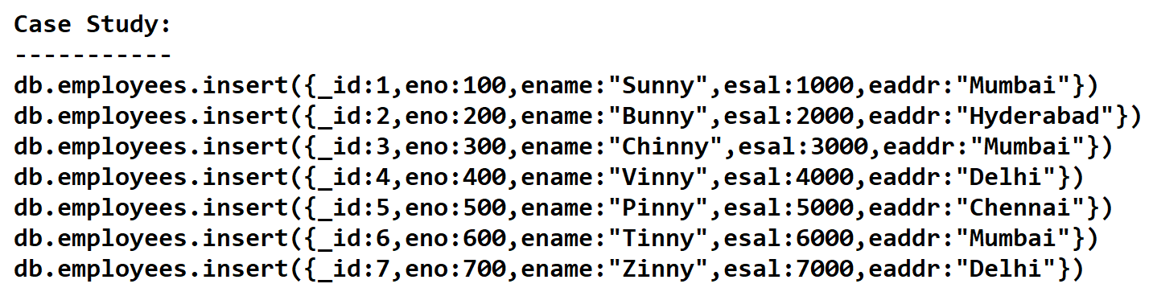

Slide 63
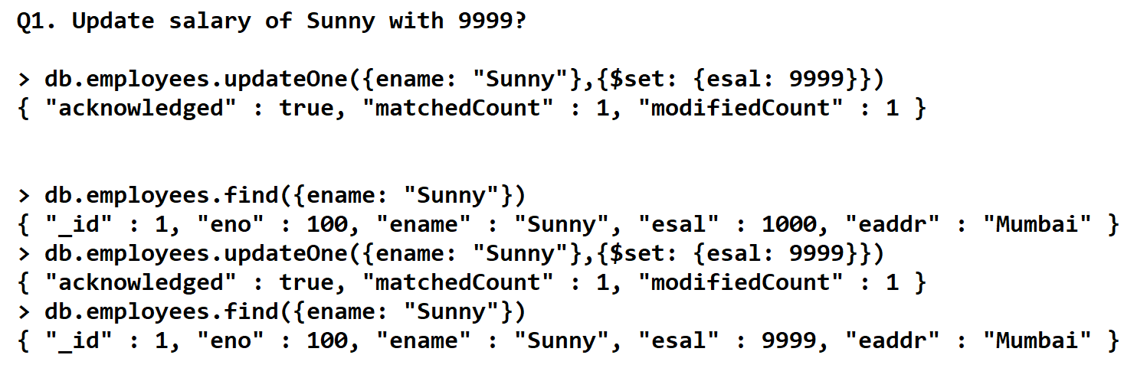

Slide 64
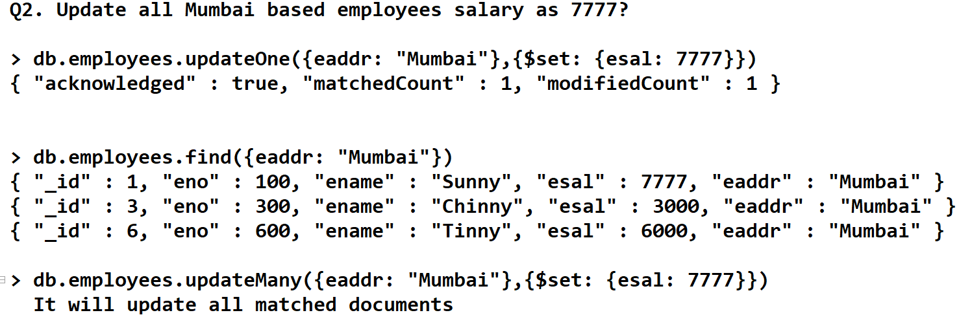

Slide 65
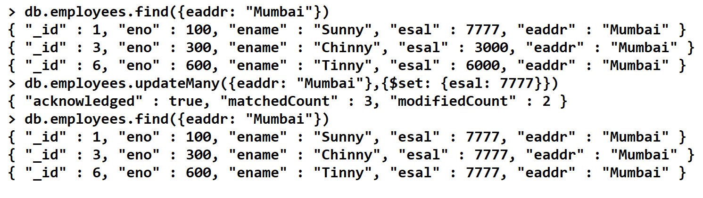

Slide 66
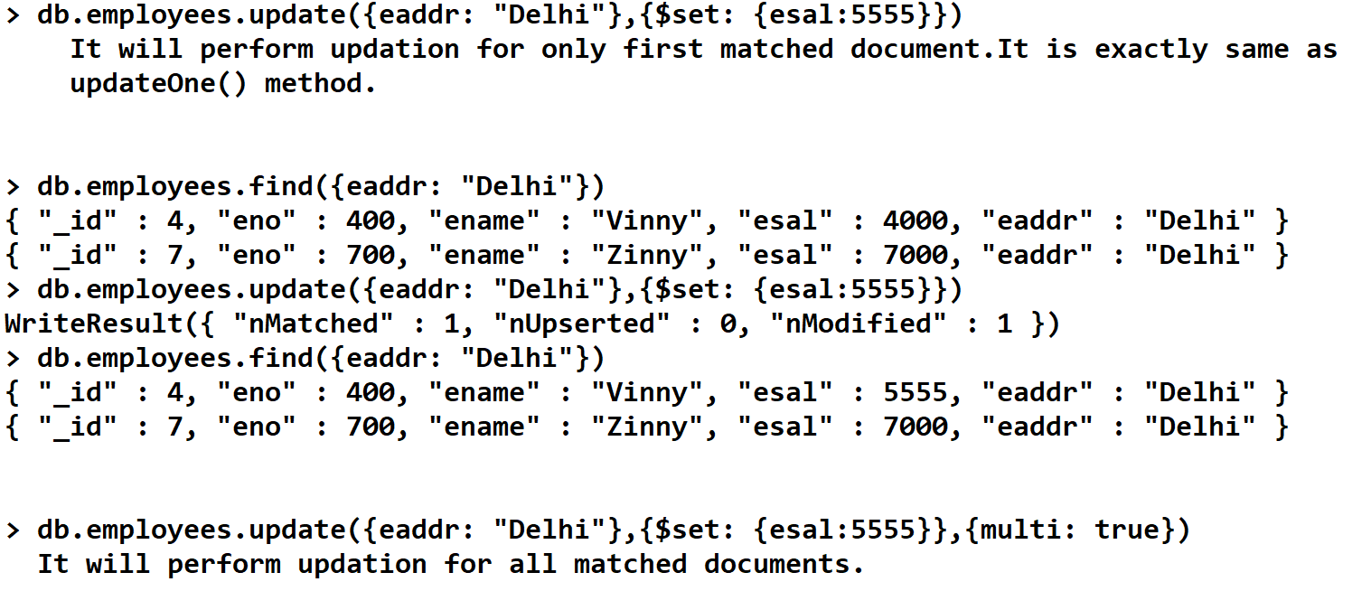

Slide 67
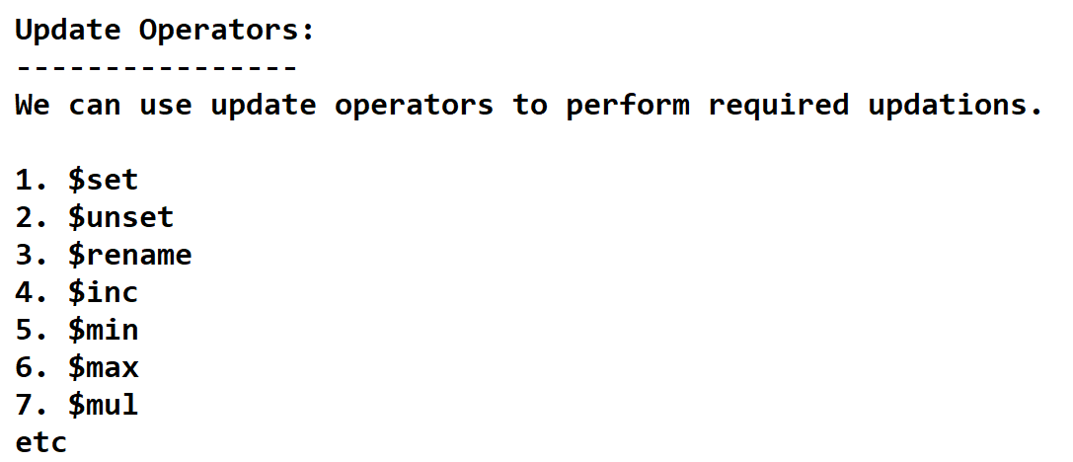

Slide 68
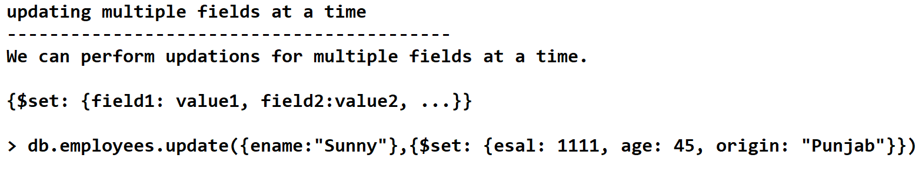
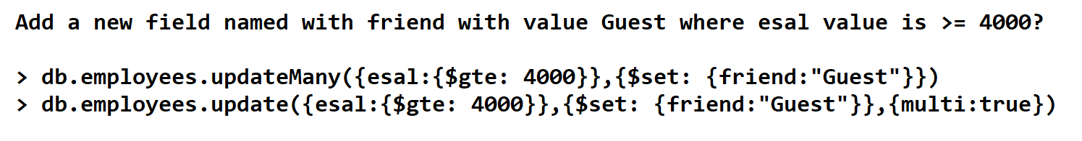

Slide 69



Slide 71
2. $unset operator:
To delete the specified field.
3. $rename operator:
We can use $rename operator to rename fields, ie to change name of the field.
Q: Write Query to rename esal as salary and eaddr as city in employees collection?
> db.employees.updateMany({},{$rename: {esal:"salary", eaddr: "city"}})

Slide 72
4. $inc operator:
inc means increment.
We can use $inc to increment or decrement value of the field with specified amount.
Increment all employee salary by 500.
>db.employees.updateMany({},{$inc: {esal:500}})
Decrement Employee salary by Rs 1 where esal is > 4700?
> db.employees.updateMany({esal:{$gt: 4700}},{$inc: {esal:-1}})

Slide 73


Slide 74


Slide 75


Slide 76


Slide 77


Slide 78


Slide 79


Slide 80


Slide 81

999
888
1002
5000
500

Slide 82


Slide 83


Slide 84


Slide 85


Slide 86


Slide 87
Deleting Documents from the collection:
---------------------------------------
MongoDB provides the following methods to delete documents from the collection.
1. deleteOne()
2. deleteMany()
3. remove()

Slide 88


Slide 89


Slide 90


Slide 91


Slide 92


Slide 93


Slide 94


Slide 95


Slide 96


Slide 97


Slide 98


Slide 99


Slide 100


Slide 101


Slide 102


Slide 103



Slide 104

aggregation

Slide 105


Slide 106



Slide 107


Slide 108


Slide 109


Slide 110


Slide 111


Slide 112


Slide 113


Slide 114


Slide 115


Slide 116


Slide 117


Slide 118
Indexing
Indexing is DBMS related concept and almost every database provides support.
Indexes supports efficient execution of queries in MongoDB.
Indexing concept is very helpful for find,update and delete queries.
The main objective of indexing is to improve performance.
Without indexes, server will scan all documents present in the collection to find matched documents. This is called Collection Scan(COLLSCAN).
Whenever we are defining index, MongoDB Server will store values of indexed field in B-Tree Data structure in specified sorting order.
To find matched documents, we are not required to scan all documents,server can identify matched documents directly based Index Scan(IXSCAN).
As the number of documents to be scan, is reduces and hence performance will be improved.

Slide 119


Slide 120


Slide 121




Slide 122



Slide 123



Slide 124



Slide 125
https://www.mongodb.com/developer/products/mongodb/mongodb-schema-design-best-practices/

